Slide 1
2023년 10월 10일 컴퓨터 비전 특론
EfficientNetV2
-Smaller Models and Faster Training
한수호

Slide 2
Introduction

Slide 3



Introduction
01

Slide 4
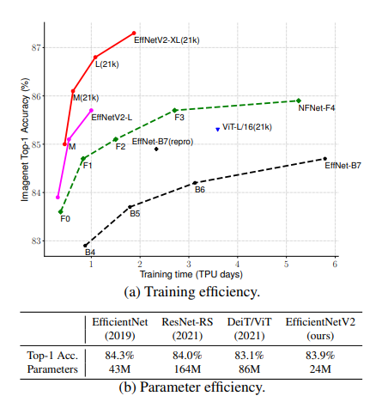
Introduction
01
성능을 올리면서 동시에 훈련 효율성을 가질 수 있는 모델

Slide 5
Related work

Slide 6
Training and parameter efficiency
02
Resnet
TResnet
EfficientnetX
GPU 추론속도,정확도
EfficientnetV2
훈련속도 / Parameter 효율성

Slide 7
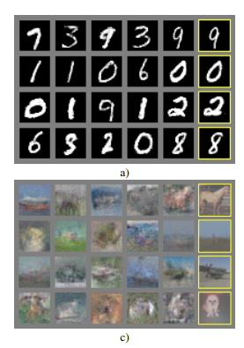
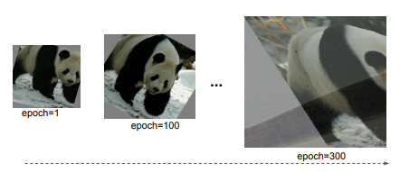
Progressive training / mix&match
02
Same regularization
Adjust regularization
GAN
Mix&Match
EfficientnetV2

Slide 8
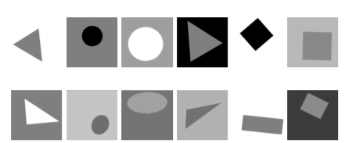
Curriculum learning
02
Easy sample
Difficult sample

Slide 9
Method

Slide 10
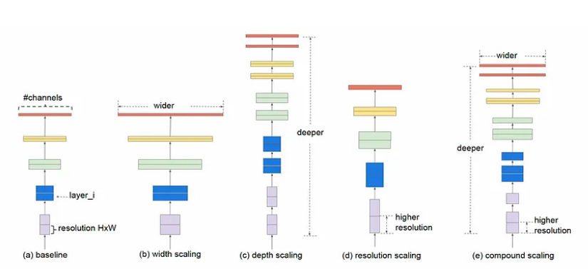
EfficientnetV1
03

Slide 11
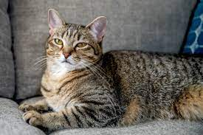
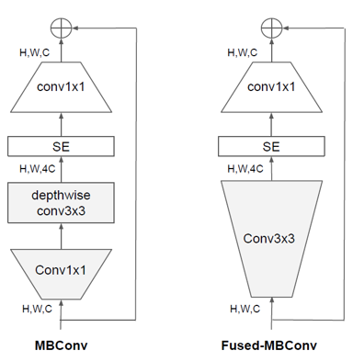
EfficientnetV1 -> EfficientnetV2
03
EfficinetnetV1
EfficinetnetV2
Imagesize
Depthwise convolution
Compound scaling

Slide 12
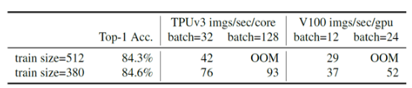
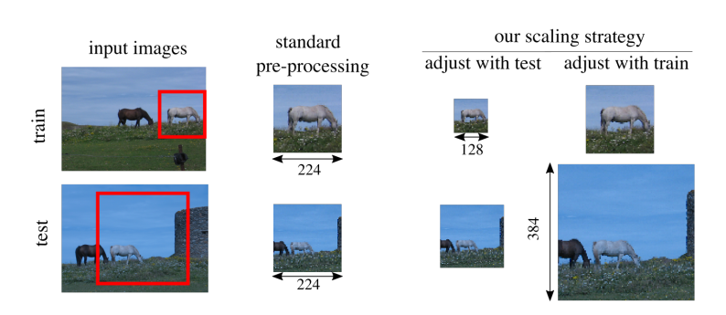
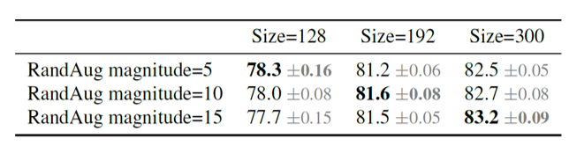
Training with very large image sizes is slow
03
EfficinetnetV1-B0 : 224 by 224
EfficinetnetV1-B7 : 600 by 600
FixEfficientNet
Progressive Learning with
adaptive regularization

Slide 13
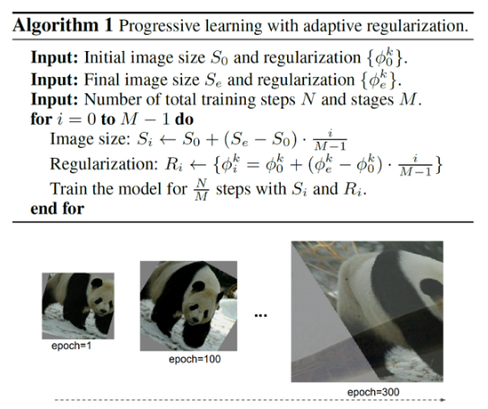
Training with very large image sizes is slow
03
regularization
dropout
randAugment
Mixup

Slide 14
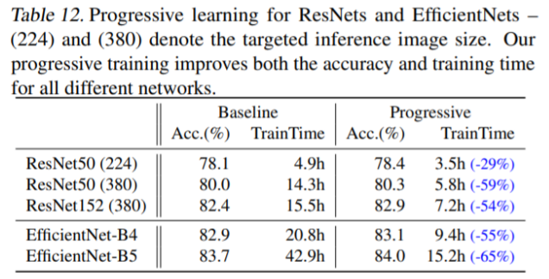
Training with very large image sizes is slow
03

Slide 15
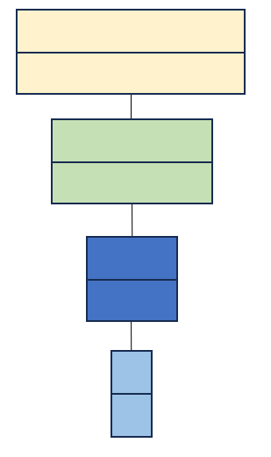
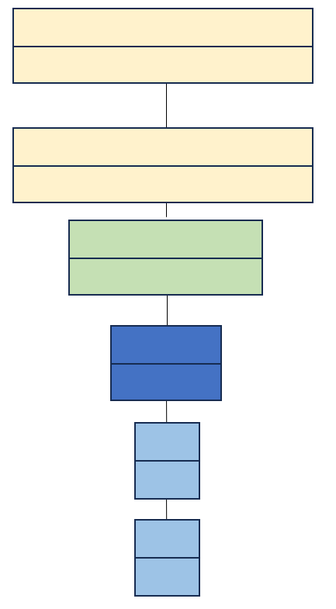
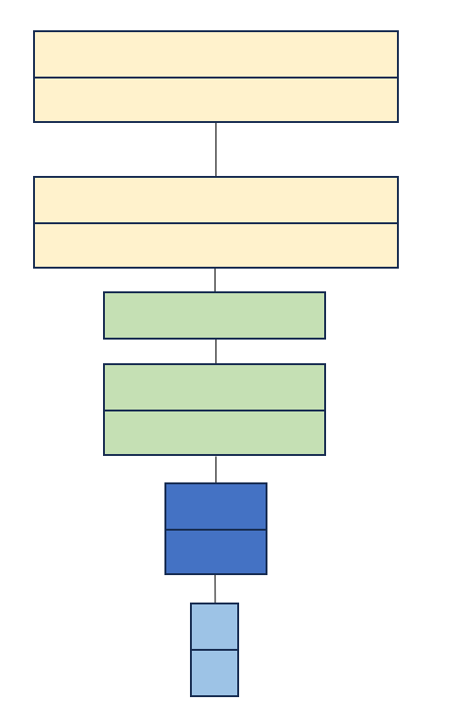
Equally scaling up every stage is sub-optimal
03
baseline
EfficinetnetV1
EfficinetnetV2

Slide 16
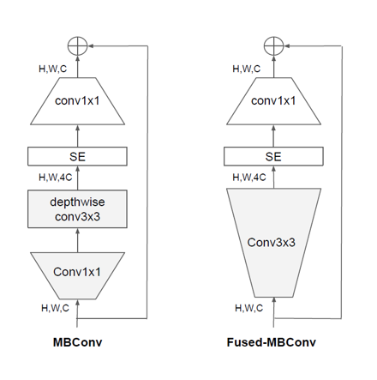
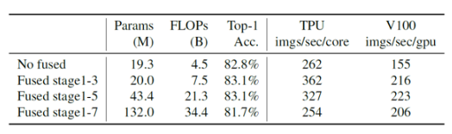
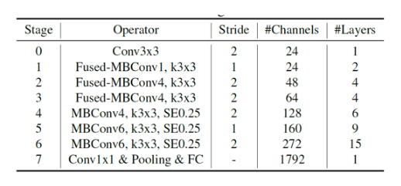
Depthwise convolutions are slow in early layers
03
1
2

Slide 17
Experiment

Slide 18
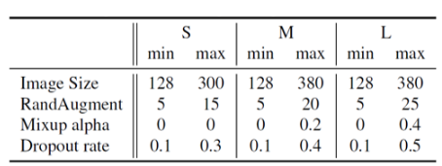
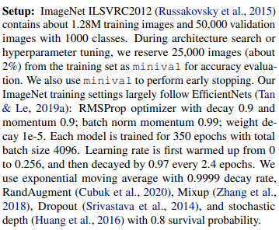
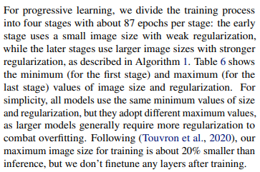
Result
03
ImageNet-ILSVRC2012
ImageNet21k

Slide 19
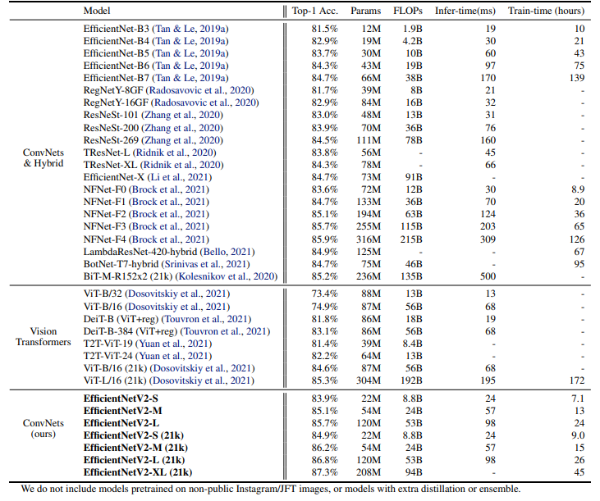
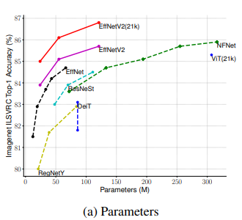
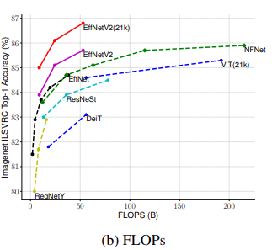
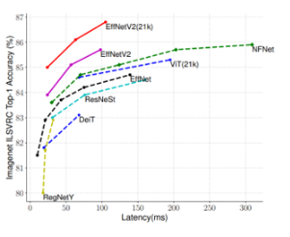
Result
03

Slide 20
Conclusion&Discussion

Slide 21
Conclusion&Discussion
06

Slide 22
End

